Slide 1
System Identification of a DC Servo Motor Using ARX and ARMAX Models
ECE 621
Spring 2022
Nathaniel Wooley

Slide 2
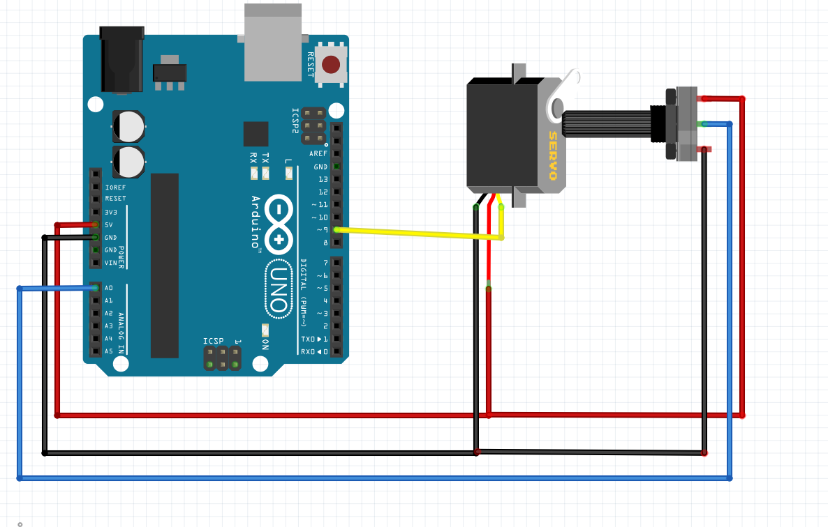
System Identification of a DC Servo Motor
System
Objectives:
To apply system identification to a DC Servo motor to
produce a mathematical model of the system using
experimental data.
Expected Results:
To produce a model of the selected motor that will
predict the outputs of the analyzed system with an
accuracy of 90% or greater.
Relevance for the Professionals:
Creating a reliable method to accurately simulate the
behavior of a DC servo motor provides great
utility for implementation in simulations and high
precision control loops.
Next Steps:
Explore modeling different types of motors and apply this model in robotic simulations.
Data
Project Schedule
Data Collection: 3/15 Model Development: 4/20 Report & Presentation: 5/1
Project Cost
Arduino: $ 25 Servo Motor: $ 5 Potentiometer: $ 1 Time: 30 @ $10/hr $ 300
Total Cost: $ 331

Slide 3
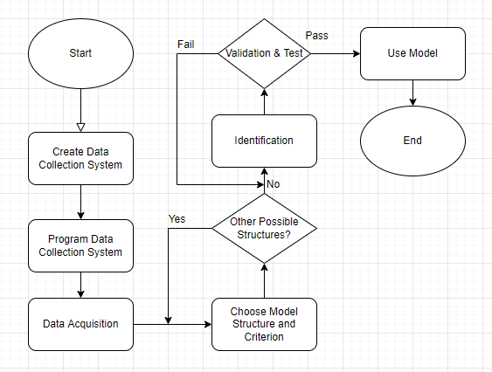
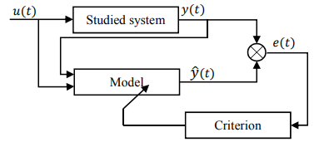
Technical Approach
Chose an approach similar to the source paper, with the exception of data collection.
Iterative approach with multiple inputs, multiple test data sets and different model structures led to many different estimations that while similar, yielded different result.
Prediction Error Method yielded more refined results.
MATLAB System Identification Toolbox utilized for parameter estimation.

Slide 4
Results
Created and tested over 20 different systems, similar to the source paper.
Noise in the system output didn’t plan a large role in the estimations.
Able to get every system estimated over 80% accuracy when compared to system outputs. Some estimations able to achieve over 94% accuracy when estimating in the best-case scenarios.
ARX model estimations usually more accurate than ARMAX model estimations.

Slide 5
Issues or Concerns
Models with the highest accuracy also had the highest final prediction error.
ARX with Sinusoid Input: Best Fit %: 94.505% FPE: 7.766
No clear ‘best’ model due to best fit percentage and final prediction error not agreeing.

Slide 6
Summary
Successfully created over 32 individual models that all achieved accuracy over 80%, and four that achieved an accuracy of 94% accuracy.
Tested the created models against independent test data to get unbiased performance metrics
Explored other model structures, such as IV4 – a four stage instrumental variable method but found that ARX and ARMAX were consistently the more effective options.

Slide 7
References
S. Mokhlis, S. Sadki and B. Bensassi, "System Identification of a DC Servo Motor Using ARX and ARMAX Models," 2019 International Conference on Systems of Collaboration Big Data, Internet of Things & Security (SysCoBIoTS), 2019
“System identification toolbox,” MATLAB. [Online]. Available: https://www.mathworks.com/products/sysid.html.

